Slide 1


To design and simulate a dielectric modulated and double AlGaN barrier plasma-based MOSHEMT for bio-sensing applications
Mid-Review 1
Major Project
Project ID: V17
AY 2021-25
GITAM (Deemed-to-be) University
Project Team:
KOUSHITHA C
NAGA CHAITANYA SV-
MEGHANA M
Department of Electrical Electronics and Communication Engineering
Project Mentor:
Dr Girish Shankar Mishar
www.gitam.edu

Slide 2
Generate Id-Vd and Id-Vg curves and sensitivity graphs by introducing various biomolecules.
Validate sensitivity graphs against data from the literature.
Submit a research paper to an IEEE conference
Objective and Goals
Objective
Goals
Main Goals
Design and Simulation
High Sensitivity Biosensing
Dual-Channel Optimization
Id-Vd and Id-Vg Curves Analysis
Charge Plasma Technique Validation
Dielectric Modulation Efficiency
Additional Goals
Literature Comparison
Scalability Assessment
Power Consumption Optimization
Research Publication

Slide 3
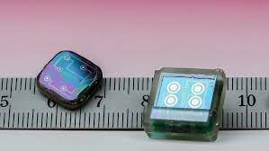
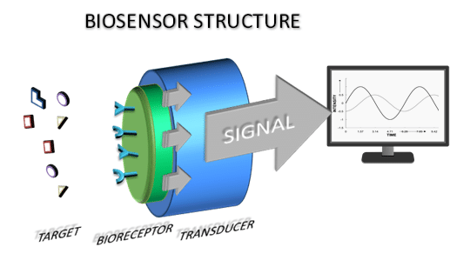
DEFINITION OF BIOSENSORS:
A biosensor is a device that detects and measures biological molecules by converting a biological response into an electrical signal.(definition)
(fig:1) Biosensor
DESCRIPTION OF BIOSENSOR:
A biosensor is an analytical device that combines a biological recognition element with a physicochemical detector to detect and quantify specific biological molecules, providing rapid and sensitive measurements in various applications such as medical diagnostics and environmental monitoring
(fig:2)Biosensor structure

Slide 4
(fig:1)

Slide 5
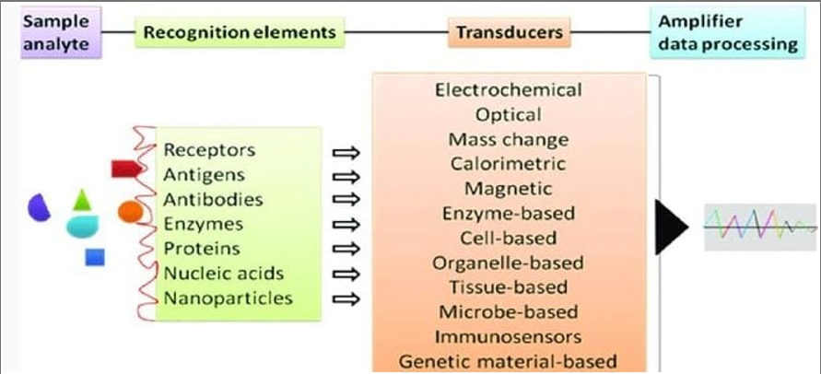
FUNCTIONS OF BIOSENSOR:
Detection
Quantification
Monitoring
Diagnosis
Environmental Monitoring
Food Safety
Bioprocess Control
Security
(fig:3) Functions of Biosensors

Slide 6
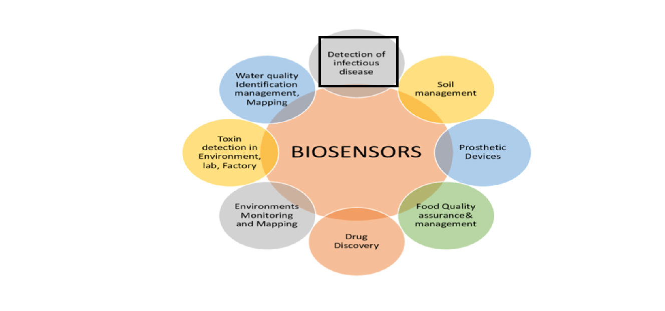
APPLICATION OF BIOSENSOR:
(fig:4) Applications of Biosensor

Slide 7
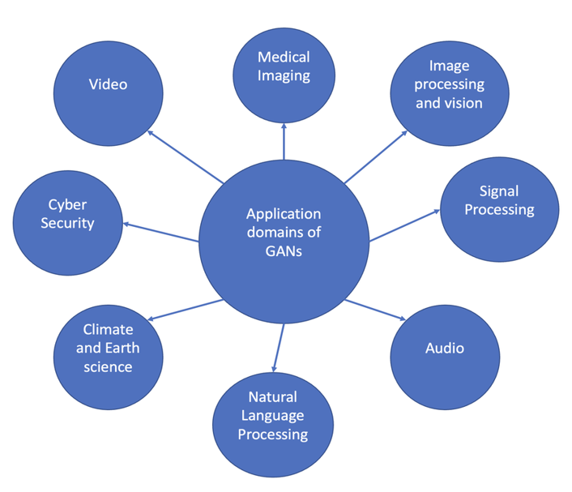
APPLICATIONS OF GaN:
(fig:5) Applications of GaN

Slide 8
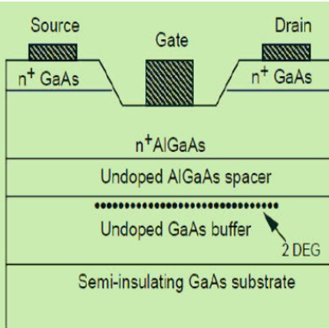
INTRODUCTION TO HEMT:
A High Electron Mobility Transistor (HEMT) is a special type of field-effect transistor known for its high speed and efficiency. It uses a combination of materials with different energy band gaps to create a very fast-moving layer of electrons, which makes it perfect for high-frequency applications like satellite communications, radar systems, and even in modern smartphones. HEMTs are like the speedy superheroes of the electronics world, working tirelessly to keep our advanced tech running smoothly!
ADVANTAGES
1. High-Frequency Operation
2. Low Noise
DISADVANTAGES:
1.High Fabrication Cost
2.Thermal Management
(fig:6) HEMT Structure

Slide 9
Key Features of HEMT
High Electron Mobility: HEMTs exhibit extremely high electron mobility due to the unique heterostructure design, enabling faster signal processing and high-frequency operation.
Low Noise: HEMTs have low noise figures, making them suitable for use in sensitive communication devices like satellite receivers and radar systems.
Wide Bandgap Materials: They often utilize wide bandgap materials like GaAs or GaN, which contribute to their superior performance in high-power and high-temperature environments.
Scalability: HEMTs can be scaled down in size, making them compatible with modern, miniaturized electronic devices.
High Thermal Conductivity: HEMTs, especially those made with materials like GaN, have high thermal conductivity, which helps in effective heat dissipation, enabling operation at higher power levels.
High-Frequency Performance: HEMTs are ideal for high-frequency applications, such as microwave and millimeter-wave circuits, due to their ability to operate efficiently at these frequencies
High Power Density: HEMTs can deliver high power density, making them ideal for compact, high-power applications like power amplifiers in wireless communication systems.

Slide 10
Project Plan (Clearly mention milestone for objectives under each reviews)
Gant Chart - Milestones and Activities
Resources : https://www.officetimeline.com/gantt-chart/how-to-make/excel & https://www.teamgantt.com/
Months | WEEK 1(December) | WEEK 2(December) | WEEK 3(Jan) | WEEK 4(jan) | WEEK 5(Feb) | WEEK 6(Feb)
PHASE 1 (Extended abstract) | X | X
PHASE 2 ( adding of Physics file ) |  | X | X
PHASE 3 ( Validation)
PHASE 4 (IdVd and IdVg graphs)
PHASE 5 (Submitting papers to IEEE conference)

Slide 11
Literature Survey (Improved post minor project)
Key Publications(1)
Analytical Modeling of AlGaN/GaN MOS-HEMT for High Sensitive pH Sensor
Authors: Praveen Pal, Yogesh Pratap, Mridula Gupta, Sneha Kabra.
Published In: IEEE Sensors Journal, 2021.
Summary: Proposes a physics-based analytical model for pH detection, achieving high sensitivity beyond the
limit.
Analytical Modeling of AlGaN/GaN MOS-HEMT for High Sensitive pH Sensor
Whitepaper: Analytical modeling for pH detection using AlGaN/GaN MOS-HEMT.
Application Notes: Optimization of cavity length and AlGaN barrier properties.
Datasheet: Sensitivity metrics (drain current and threshold voltage).Performance .Analysis of MOS-HEMT as
Biosensor)
Analytical Modeling and Simulation of AlGaN/GaN MOS-HEMT for High Sensitive pH Sensor:
Products: Prototype AlGaN/GaN MOS-HEMT sensors optimized for pH detection in medical diagnostics.
Open Source: Analytical models and simulation results verified using tools like TCAD.
GitHub: Likely repositories focusing on HEMT-based device modeling and pH sensor simulations (not explicitly
mentioned)

Slide 12
Literature Survey (Improved post minor project)
Key Publications(2)
Performance Analysis of MOS-HEMT as Biosensor: A Dielectric Modulation Approach
Authors: Ritu Poonia, Aasif Mohammad Bhat, C. Periasamy, Chitrakant Sahu.
Published In: Malaviya National Institute of Technology, 2021.
Summary: This paper examines the impact of dielectric modulation on biomolecule detection using MOS-HEMT devices, optimizing sensitivity via cavity design​.
Performance Analysis of MOS-HEMT as Biosensor: A Dielectric Modulation Approach
Whitepaper: Dielectric modulation for detecting biomolecules using MOS-HEMT.
Application Notes: Cavity design and biomolecule impact on device performance.
Datasheet: Threshold voltage and drain current variation for neutral and charged molecules.Normally-Off AlGaN/GaN MOSHEMT for Label-Free Biosensing.
Performance Analysis of MOS-HEMT as Biosensor: A Dielectric Modulation Approach :
Products: MOS-HEMT-based biosensors for detecting charged and neutral biomolecules.
Open Source: Simulation studies using Silvaco Atlas to optimize device sensitivity and cavity design.
GitHub: Potential open-source projects focusing on dielectric modulation for biosensor applications.

Slide 13
Literature Survey (Improved post minor project)
Key Publications(3)
Normally-Off AlGaN/GaN MOSHEMT as Label-Free Biosensor
Authors: S. N. Mishra, Rajesh Saha, Kanjalochan Jena.
Published In: ECS Journal of Solid State Science and Technology, 2020.
Summary: Highlights the use of dielectric modulation and nano-gap structures for label-free biosensing with enhanced sensitivity
Normally-Off AlGaN/GaN MOSHEMT as Label-Free Biosensor:
Whitepaper: Novel gate cavity dielectric modulation techniques for biosensing.
Application Notes: Use of nano-gaps and dielectric constants for enhanced sensitivity.
Datasheet: Device parameters (2DEG density, gm/Id ratio, threshold voltage sensitivity)
Normally-Off AlGaN/GaN MOSHEMT for Label-Free Biosensing
Products: Label-free biosensors employing dielectric modulation and nano-gap structures.
Open Source: Modeling using Synopsys Sentaurus to analyze gm/Id ratios and 2DEG behavior.
GitHub: Repositories could include device simulation frameworks or analytical models related to MOSHEMT biosensors.

Slide 14
Use Cases & Testing
Use Cases:
Biomedical Diagnostics
Food Safety
Environmental Monitoring
Drug Development and Testing
Wearable Healthcare Devices
Forensic Science
Veterinary Diagnostics
Industrial Biotechnology
Test Cases
Sensitivity Testing
Selectivity Testing
Stability and Repeatability
High-Frequency Performance
Effect of Dielectric Modulation
Dual-Channel Configuration
Power Consumption

Slide 15
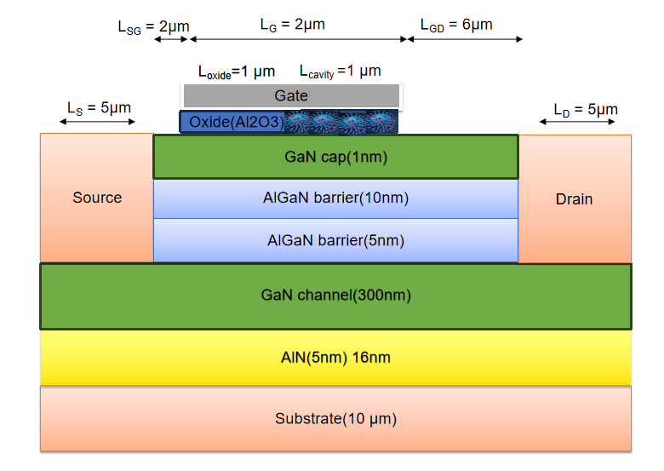
Structural Diagram
(fig:7)Structural diagram

Slide 16
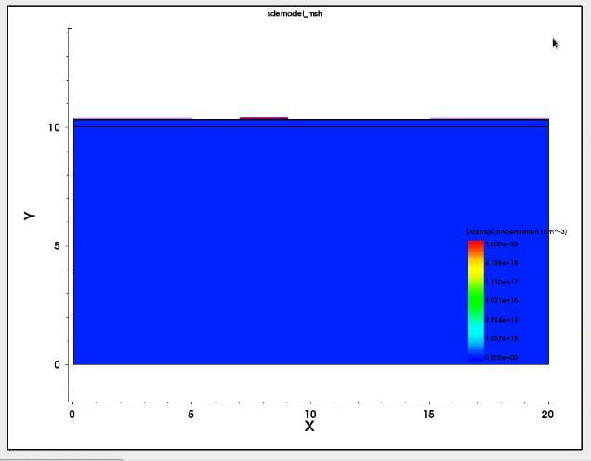
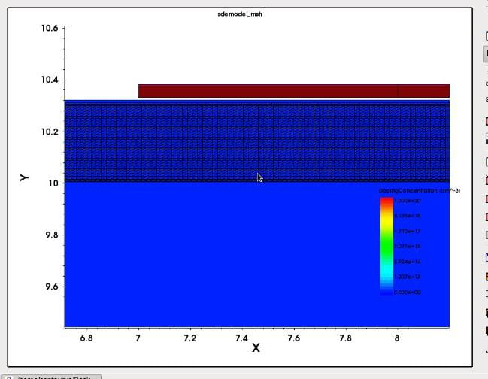
Implementation and Results – Iteration 1
Iteration 1 : Results
Iteration : Results + Validation against the use cases and test cases
(fig:8) Before meshing
(fig:9) After meshing

Slide 17
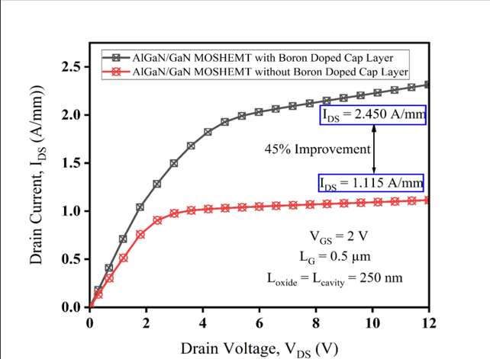
This graph represents the output characteristics of a MOSHEMT device, showing the drain current (I​DS ) versus drain voltage (​ VDS) for different gate-to-source voltages(VGS)
As increases significantly, indicating enhanced channel conductivity and higher current flow due to stronger gate control

Slide 18
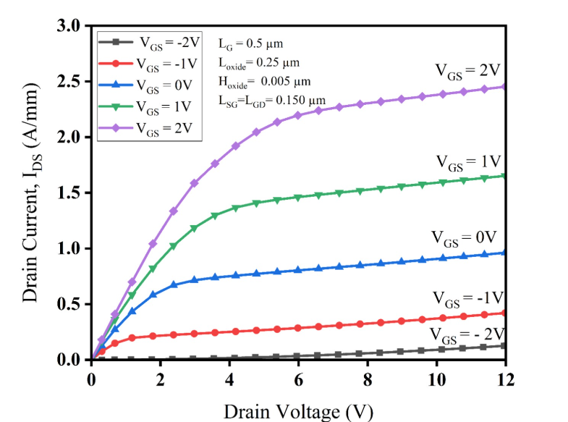
The graph presents the output characteristics (I-V curve) of the dielectric modulated and double AlGaN barrier plasma-based MOSHEMT.
As V_GS increases, the drain current also increases, indicating improved carrier transport and transistor performance.
These characteristics are crucial for optimizing MOSHEMT-based biosensors, enhancing sensitivity and detection efficiency.

Slide 19
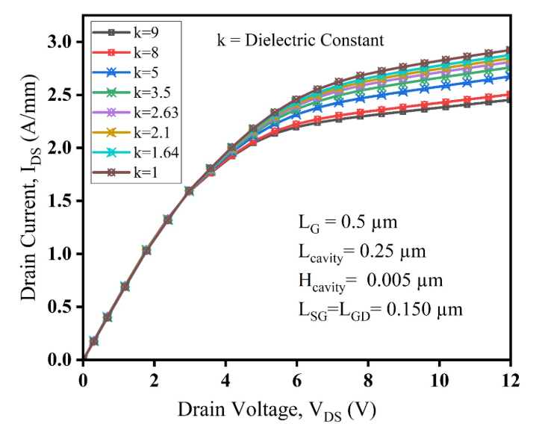
The drain current (I_DS) increases as the dielectric constant (k) increases.
At higher dielectric constants, the transistor exhibits improved carrier transport, leading to higher drain current.
The device parameters (L_G, L_cavity, H_cavity, L_SG = L_GD) influence the electrical characteristics, crucial for biosensing applications.
This behavior is essential for optimizing MOSHEMT-based sensors by selecting appropriate dielectric materials to enhance sensitivity and performance.

Slide 20
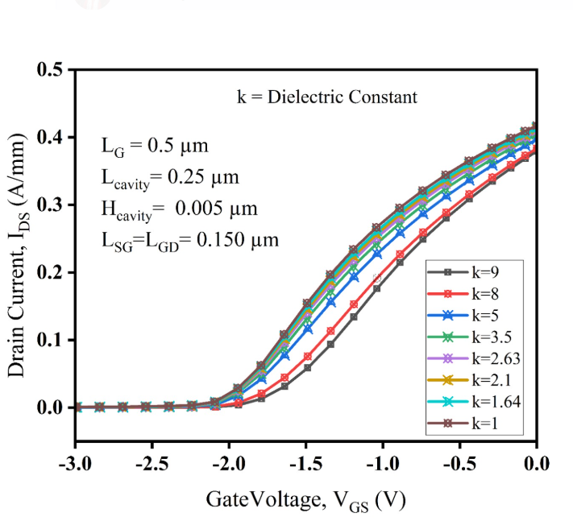
The drain current (I_DS) increases as the gate voltage (V_GS) becomes less negative, demonstrating the transistor's switching behavior.
Higher dielectric constants result in a higher I_DS, indicating improved carrier transport and enhanced device performance.
The influence of L_G, L_cavity, H_cavity, and L_SG = L_GD on device behavior is crucial for optimizing biosensor sensitivity.
This analysis helps in selecting appropriate dielectric materials to improve MOSHEMT-based biosensors.

Slide 21
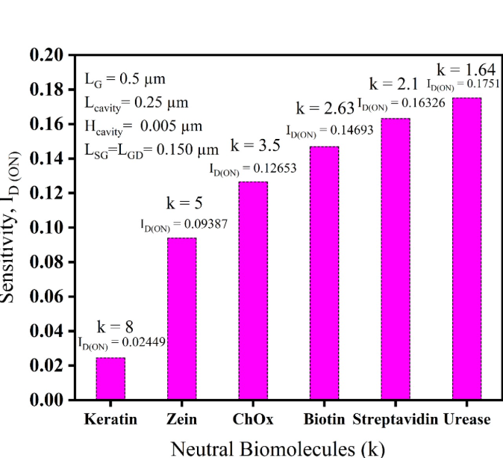
Sensitivity increases as the dielectric constant (k) decreases, indicating higher detection capability for biomolecules with lower k-values.
The highest sensitivity is observed for Urease (k = 1.64),while the lowest is for Keratin (k = 8).
This behavior demonstrates the effectiveness of MOSHEMT in differentiating biomolecules based on their dielectric properties.
The device parameters (L_G, L_cavity, H_cavity, and L_SG = L_GD) influence the overall sensitivity, critical for biosensor optimization.

Slide 22
The IDS-VDS characteristics of the AlGaN/GaN MOSHEMT with Al₂O₃ gate dielectric are represented in Fig. 1(a).
Drain current (IDS) increases as gate voltage (VGS) is varied from −2V to 2V, for VDS = 0V to 12V.
2DEG current density is maximum at high gate voltages due to stronger polarization effects and large conduction band discontinuity, leading to high current.
For lower gate voltages, the current is minimal.
Adding a dielectric below the gate helps reduce current collapse, a common issue in HEMT architectures.
The normally ON behavior in AlGaN HEMT increases leakage current, causing carriers to spill over into the substrate, which degrades device performance.
The sensing ability of the device is determined by the variation of channel conductance with respect to drain current, typically expressed in V⁻¹.
Implementation and Results – Iteration 3

Slide 23
Project Initiation:
Defined objectives, project scope, and roles for team members.
Completed literature review to understand state-of-the-art technology.
Simulation and Design Phase:
Designed the MOSHEMT structure using TCAD tools.
Conducted initial simulations for Id-Vd and Id-Vg characteristics.
Analysis and Validation:
Analyzed sensitivity graphs and compared results with the literature.
Identified areas for improvement in design and materials.
Documentation and Reporting:
Prepared detailed reports, extended abstracts, and presentations.
Drafted a research paper for submission to IEEE conferences.
Contribution
Team Progress and Movement
Individual Contribution
Key contributions: Challa koushitha
PPT, Literature paper
Key contributions: Naga chaitanya sv
Literature paper ,PP
Key contributions: Martha Meghana
Literature paper, PPT

Slide 24
Conclusion & Future Work
Summary :
The project focuses on designing and simulating a dielectric-modulated, double AlGaN barrier MOSHEMT for biosensing applications. Leveraging charge plasma technology and dual-channel configuration enhances sensitivity, selectivity, and scalability in detecting biomolecules. Simulation results confirm improved electrical characteristics and device performance, making it suitable for healthcare diagnostics, environmental monitoring, and food safety applications.
Conclusion: The proposed MOSHEMT demonstrates high potential for real-world biosensing applications. Future work includes experimental validation and integration into portable diagnostic systems for broader use.
Future Work:
By adding an AlGaN/GaN layer below the GaN channel,2 DEG improves the current and sensitivity
By adding a dual metal gate/gate engineering technique , the device structure can function in E-mode operation

Slide 25
THANK YOU
Have a Great Day !

